Slide 1

Date: | Human Biology Year 12 ATAR
Do Now Past exam question Thermoregulation Lesson Agenda 1: Do Now 2: Blood Glucose Homeostasis 3: Lesson summary and wind-up Suggested Study Complete review worksheet, mark and correct using answer key on Connect. Read through today’s notes and textbook section NEXT LESSON Past Exam Question Blood Gas Homeostasis | Learning Aims Describe the structure of glucose, how it enters the body, how it is transported to the body cells and how it is used. Describe the normal range for blood glucose and why this needs to be stable. List the main organs involved in blood glucose regulation and describe their role. Discuss the cells of the endocrine pancreas and the role of the alpha and beta cells in regulating blood glucose. Discuss the role of the liver in blood glucose homeostasis Discuss the effects of insulin and glucagon in blood glucose homeostasis. Discuss the effect of the adrenal cortex and medulla in blood glucose regulation. Create detailed homeostatic feedback loops to describe the regulation of blood glucose.
 | Key Vocabulary Alpha cell Beta cell Glucagon Insulin Glycogen Glucose

Slide 2
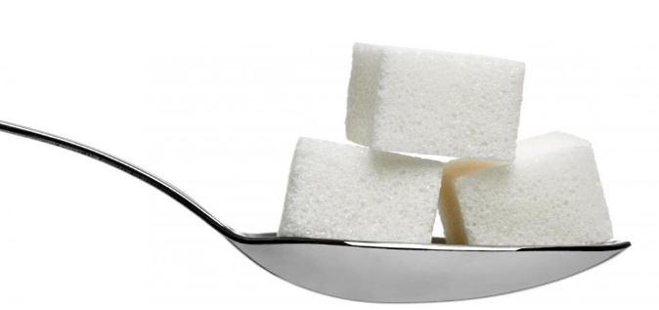
Blood Sugar Homeostasis
Ch 5 Human Perspectives

Slide 3
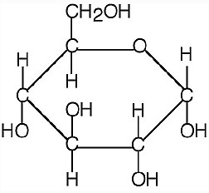
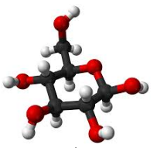

Glucose
Sugar is transported in the blood as Glucose
Glucose (C₆H₁₂O₆)
Monosaccharide (simple sugar)
Source of energy for cell’s activities
Digested carbohydrate
Enters blood stream through intestinal wall
Transported in blood – enters body cells
Energy released during cellular respiration in mitochondria
Excess glucose stored as glycogen in liver and muscles, also converted to fat.
Learning Aim: Describe the structure of glucose, how it enters the body, how it is transported to the body cells and how it is used.

Slide 4
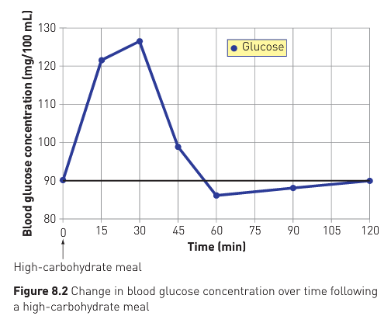
Blood Glucose
Stable glucose levels in blood mean stable supply to cells.
Normal range: 3.9-5.5 mmol/L (70-140 mg/100mL)
Rises sharply after a meal
Homeostatic mechanisms operate to bring it down to normal levels.
Excess glucose removed and stored ready for release back into the bloodstream if levels fall below normal range:
As glycogen in liver and muscles
Glycogen – long chains of glucose
Learning Aim: Describe the normal range for blood glucose and why this needs to be stable.

Slide 5
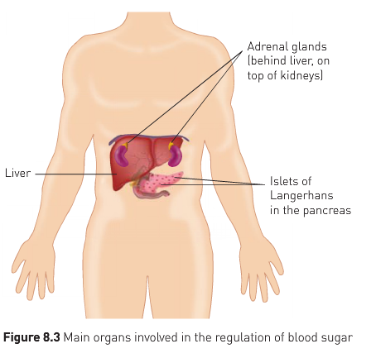
Regulation of Blood Glucose
Under hormonal control
Pancreas:
Insulin
Glucagon
Adrenal glands
Cortisol
Adrenalin and Noradrenalin
Liver is involved in storage and release of glucose in response to hormones
Learning Aim: List the main organs involved in blood glucose regulation and briefly describe their role.

Slide 6
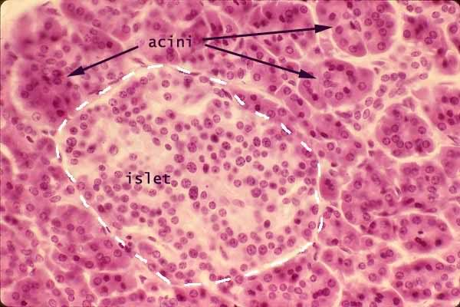
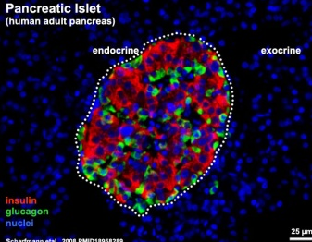
Role of the pancreas
Pancreas:
Contains clusters of insulin secreting cells “Islets of Langerhans” or “Pancreatic Islets”
Alpha cells
Detect blood glucose levels (receptor)
Act to raise blood glucose when it is too low (modulator) by secreting glucagon (messenger).
Beta cells
Detect blood glucose levels (receptor)
Act to lower blood glucose when it is too high (modulator) by secreting insulin (messenger)
Learning Aim: Discuss the structure of the endocrine pancreas and the role of alpha and beta cells in blood glucose regulation.

Slide 7
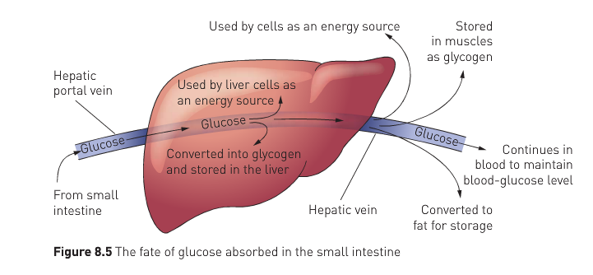
Role of Liver in blood glucose homeostasis
Liver is an effector for blood glucose homeostasis (along with body cells)
In upper abdomen
Able to convert
glucose → glycogen (storage): glycogenesis
glycogen → glucose (release back into blood): glycogenolysis
protein → glucose (release into blood) gluconeogenesis
Hepatic portal vein
Brings blood to liver from digestive tract
Glucose may be removed for storage as glycogen
May be used to provide energy for liver function
May remain in blood to go to other cells
Excess blood glucose (after glycogen) converted to fat for long term storage (lipogenesis). Lipogenesis occurs in the liver and fat cells.
Learning Aim: Discuss the role of the liver in blood glucose homeostasis.

Slide 8
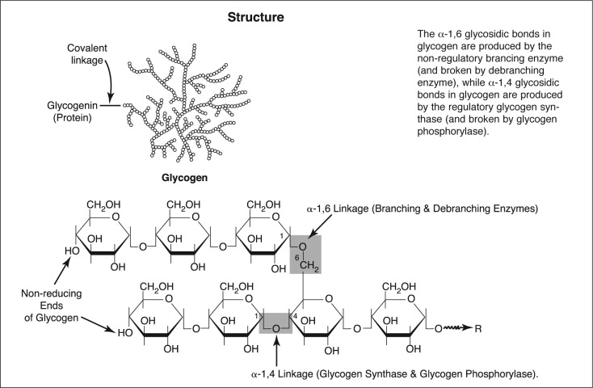
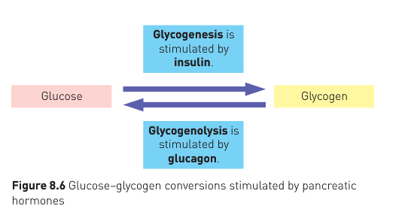
Liver – glycogen storage
Body can store 500g of glycogen:
100g in liver
400g in skeletal muscle cells – used to power muscle contraction
Glycogen:
Formed by combining glucose molecules into long chains
“glycogenesis” – in liver – stimulated by insulin from pancreas
Can’t be used directly by cells: must be converted back to glucose
“glycogenolysis” – in liver/muscles – stimulated by glucagon from pancreas
Learning Aim: Discuss the structure of the endocrine pancreas and the role of alpha and beta cells in blood glucose regulation.

Slide 9
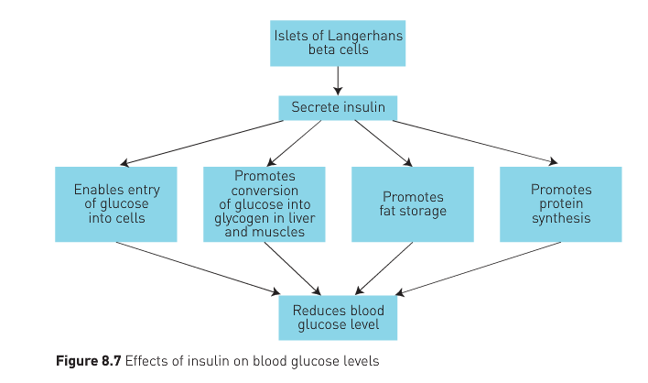
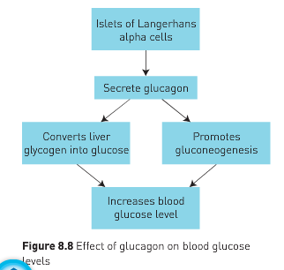
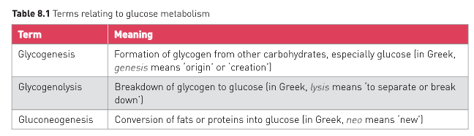
Glucagon Effects
Responses to Insulin and Glucagon
Insulin Effects
Learning Aim: Discuss the effects of insulin and glucagon in blood glucose homeostasis.

Slide 10
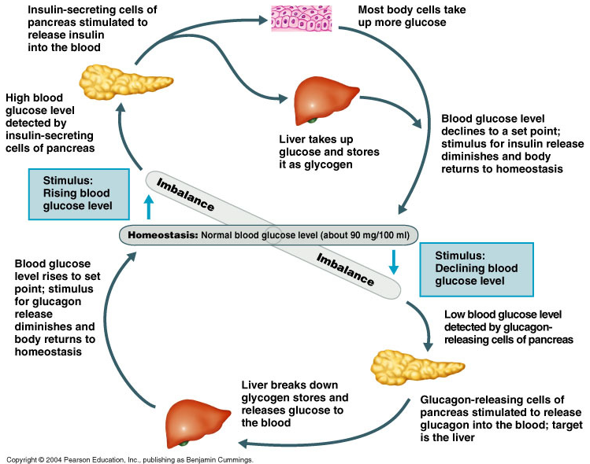
Learning Aim: Discuss the effects of insulin and glucagon in blood glucose homeostasis.

Slide 11
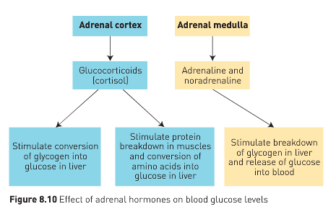
Effect of the Adrenal Glands on Blood Glucose Levels
Learning Aim: Discuss the effects of the adrenal cortex and adrenal medulla on blood glucose levels

Slide 12
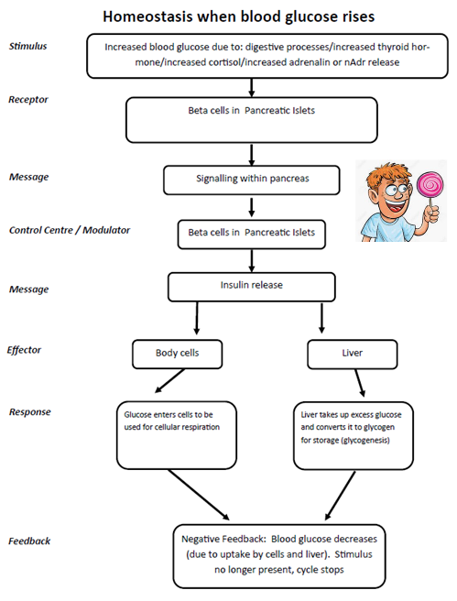
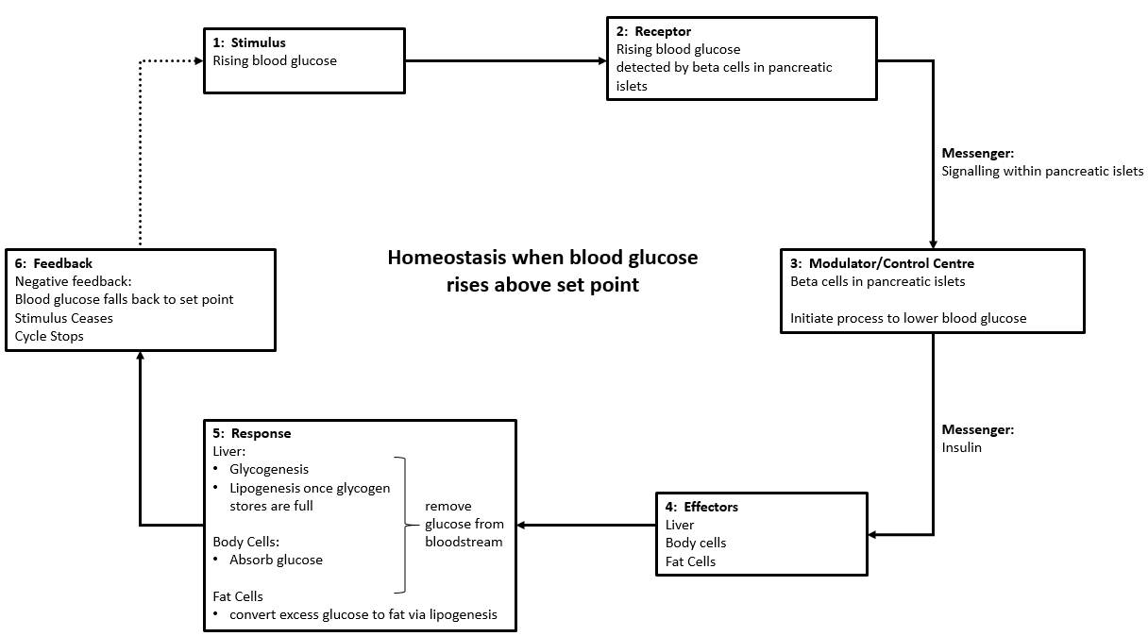
Learning Aim: Create detailed homeostatic feedback loops to describe the regulation of blood glucose.

Slide 13
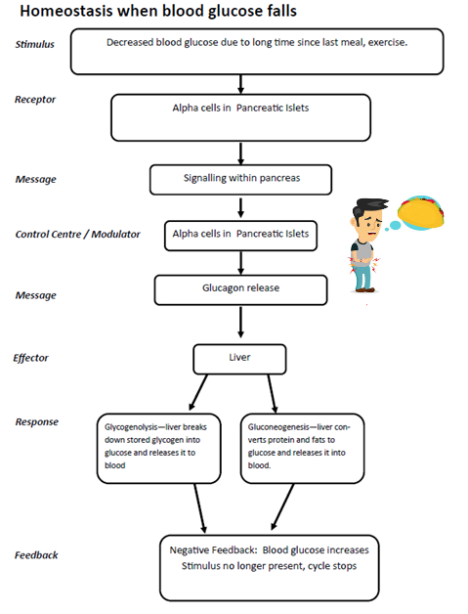
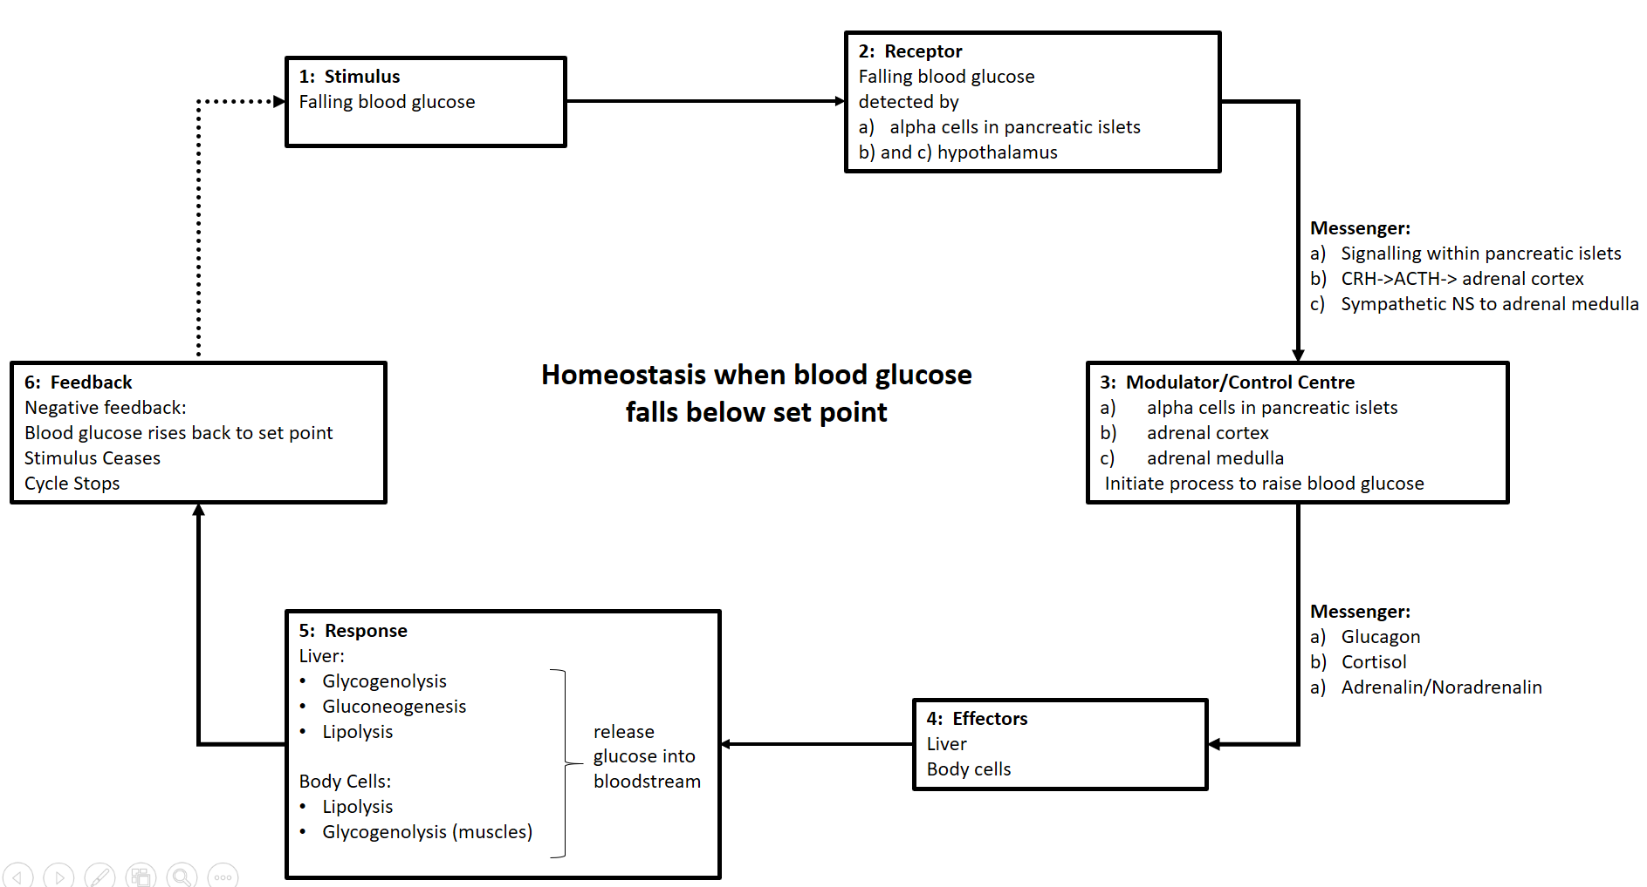
Learning Aim: Create detailed homeostatic feedback loops to describe the regulation of blood glucose.

